Slide 1

Hate Speech Detection
Group Name: Scalabe Minds
University: Mary Queen
Internship Domain: Data Science
Submitted By: Igwebuike Eze & Lucy Nowacki
Batch: LISUM32
Date: 1st July, 2024

Slide 2
Agenda
Executive Summary
Problem Statement
Project Approach
EDA Summary
nanoGPT Model Performance
nanoGPT Model Metrics
xLSTM Performance Metrics
Model Performance Comparison
Model Deployment
Recommendations
Conclusion
Future Work

Slide 3
Executive Summary
Detecting and mitigating hate speech on social media platforms is critical for fostering inclusive digital environments. Traditional large language models (LLMs) like GPT, BERT, and ILAMA are effective but resource-intensive, limiting their practicality for widespread deployment.
We used implementaion of xLSTM architecture provided from inventors [xLSTM: Efficient and Scalable Neural Networks for Sequence Learning](https://arxiv.org/abs/2405.04517) of xLSTM's technology with some modification to adjust the training for binary classifier and deploy model on Microsoft Azure
Our focus is on developing models that balance effectiveness with resource efficiency, ensuring broader accessibility and scalability by comparing NanoGPT and xLSTM models.

Slide 4
Problem Description
The term hate speech is understood as any type of verbal, written or behavioural communication that attacks or uses derogatory or discriminatory language against a person or group based on what they are, in other words, based on their religion, ethnicity, nationality, race, colour, ancestry, sex or another identity factor. In this problem, We will take you through a hate speech detection model with Machine Learning and Python.
Hate Speech Detection is generally a task of sentiment classification. So for training, a model that can classify hate speech from a certain piece of tweet can be achieved by training it on a data that is generally used to classify sentiments. So for the task of hate speech detection model, We will use the Twitter tweets to identify tweets containing Hate speech.

Slide 5
Project Approach
Data Collection
Data Processing
Model Development
Evaluation
and
Comparon
Model
Deployment

Slide 6
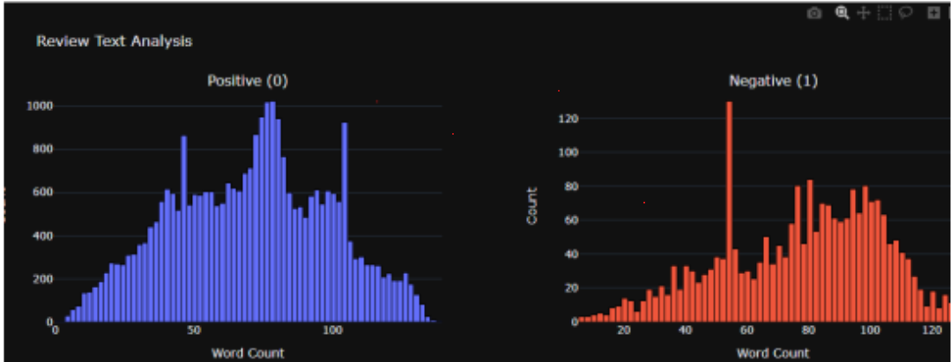
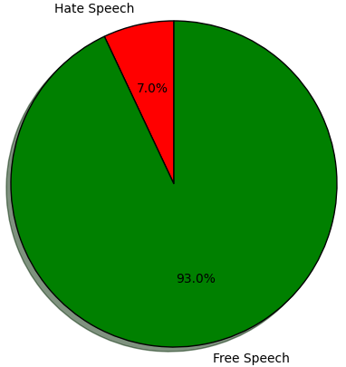
EDA
Observations / Findings
The pie chart showed that the train data is highly umbalanced with 7% hate speech and 93% free speech
The word count showed the count of unique word in the corpus

Slide 7
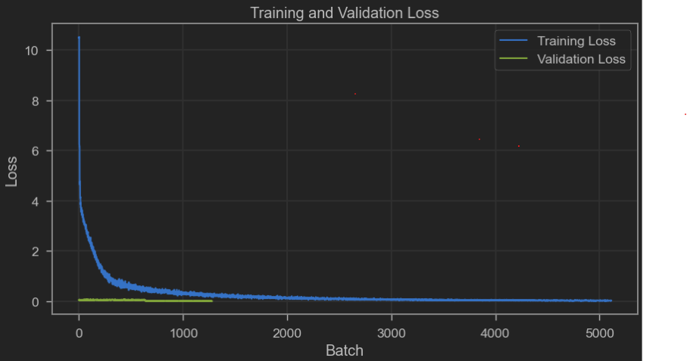
nanoGPT Model Performance
Observations / Findings
The chart shows a modest training and validation loss for our nanoGPT model that will perform optimally well. It shows a a constantly decreasing loss as the number of batch increases.
Performance optimisation can be further acheived with increased number of parameters and batch.

Slide 8
nanoGPT Model Metrics
Pooling | mean |  | cls |  | max |  | weighted |  | Hybrid
Class | 0 | 1 | 0 | 1 | 0 | 1 | 0 | 1 | 0 | 0.00
Precision | 0.93 | 0.80 | 0.93 | 0.80 | 0.93 | 0.00 | 0.93 | 0.80 | 0.93 | 0.00
Recall | 1.00 | 0.05 | 1.00 | 0.05 | 1.00 | 0.00 | 1.00 | 0.05 | 1.00 | 0.00
F1-Score | 0.96 | 0.10 | 0.96 | 0.10 | 0.96 | 0.00 | 0.96 | 0.10 | 0.96 | 0.00
Accuracy | 0.9314 |  | 0.9319 |  | 0.9286 |  | 0.93148 |  | 0.9286
Observations / Findings
Attention CLS Token Pooling has the highest accuracy (0.9320) and performs better than others in terms of precision and recall for label 1.
Attention Mean and Weighted Pooling also perform well, but their accuracy is slightly lower than attention_cls. Attention Max and Hybrid Pooling have the same accuracy (0.9287), which is lower than the other strategies, and they both have poor F1-scores for label 1.

Slide 9
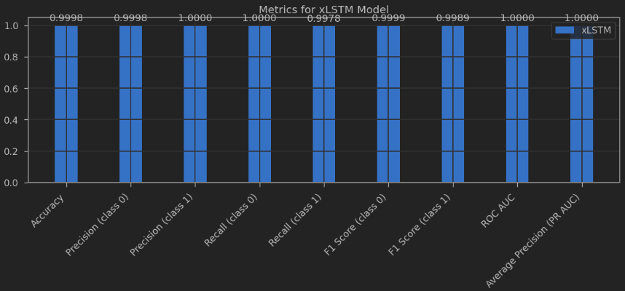
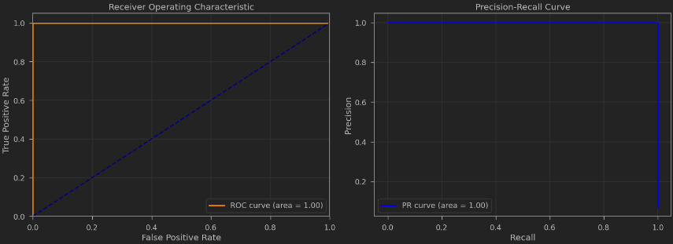
xLSTM Performance Metrics
Observations / Findings
The performance metrics shows a near perfect (100%) model. It depicts the superiority of xLSTM in hate speech detection among major LLMs.

Slide 10
Model Performance Comparison
Model | NanoGPT |  | xLSTM
No. of Params(M) | 29.95 |  | 6.68
Accuracy | 0.9271 |  | 0.9987
ROC AUC | - |  | 1.0000
Class | 0 | 1 | 0 | 1
Precision | 0.93 | 0.00 | 0.9990 | 0.9958
Recall | 1.00 | 0.00 | 0.9997 | 0.9876
F1-Score | 0.96 | 0.00 | 0.9993 | 0.9917
Observations / Findings
nanoGPT achieves an accuracy of 0.9271, which is significantly lower compared to the xLSTM's accuracy of 0.9987.
nanoGPT model exhibits poor performance in detecting class 1 (hate speech) with a precision, recall, and F1-score of 0.00 while xLSTM model shows near-perfect scores for both classes.

Slide 11
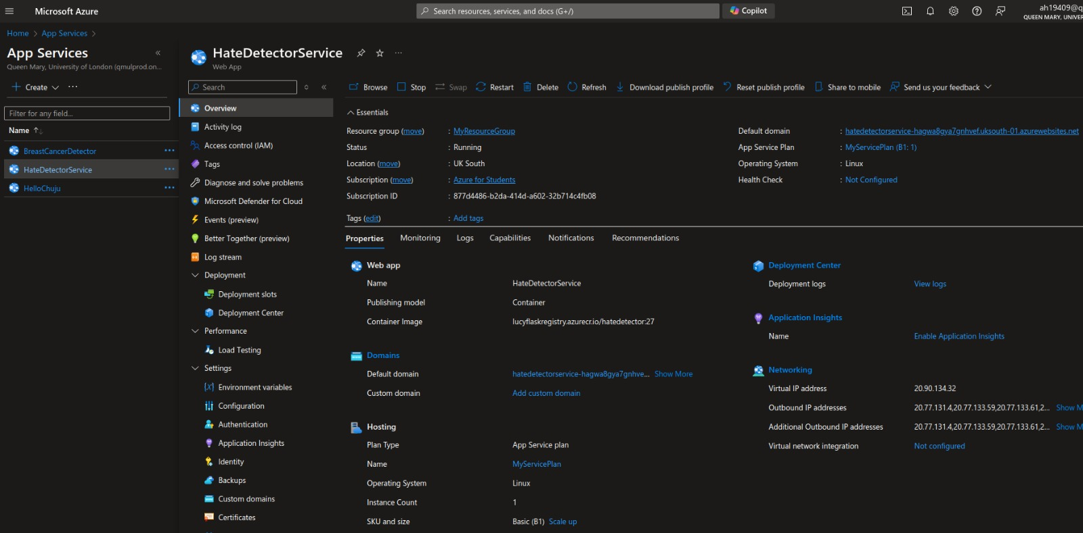
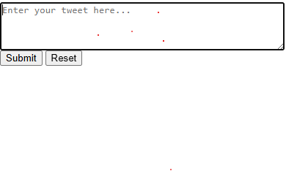
Model Deployment
Observations / Findings
Image1 shows Azure App configuartion for our HateDetectorService while image 2 is screenshop of https://hatedetectorservice-hagwa8gya7gnhvef.uksouth-01.azurewebsites.net/ to test workability of our app.
Model performance is good but more training is needed on large dataset.

Slide 12
Recommendations
1. xLSTM model outperforms the nanoGPT model in terms of accuracy, precision, recall, and F1 score and does so with significantly fewer parameters making it a more efficient and effective solution for hate speech detection.
2. xLSTM offers superior performance while being resource-efficient, providing a strong competitive advantage in the NLP market.
3. Training using very large dataset will improve hate speech detection ability.

Slide 13
Conclusion
The comparative analysis clearly demonstrates that the xLSTM model not only outperforms the nanoGPT model in terms of accuracy, precision, recall, and F1 score but also does so with significantly fewer parameters. This makes the xLSTM model a more efficient and effective solution for hate speech detection which still needed more ytraining on large dataset for optimum performance.

Slide 14
Future Work
We will make better hate detection by:
Augmentation of the training data by abusive wording from the language dictionary using another than GPT2 embedding
Incorporating pretraining loop in which the model will learn next word instead of binary classification
Ensemble model by stacking xLSTM and GPT in residual block, where say, learning signal nanoGPT : xLSTM is 1:3
Using adversarial training based on synthetic data augmentation on the ongoing basis during training
Incorporating external liquid layers that will learn how to set up residual connections between blocks, blocks and so on
Current model is not trained enough since it should be trained on much larger number of tokens and conditionaly take into account abusive dictionary and phrases.

Slide 15
Samson & Lucy
Say
Thank You

